Slide 1
Communication, Estimation & Negotiation
Rahul Mohandas

Slide 2
S1-25_SEZG509 Communication, Estimation & Negotiation
Session #6 – Sunday, 31 Aug 2025
Rahul Mohandas

Slide 3
Discussion Topics – Week 5
Inspiring teams
Story Telling
Playing to your strengths
Transitioning from Engg to PM
3

Slide 4
Week 6
Communication: External Stakeholders
Engaging with customers
Engaging with partners (suppliers/ resellers)
Building positive external relationships
Strategy Co-creation with Customers/ Partners/ Suppliers
Customer Advisory Boards
4

Slide 5
Rumsfeld Matrix
Rumsfeld Matrix
Unknown Knowns
Unknown Unknowns
Known Knowns
Known Unknowns
5
Notes:
Why It’s an Unknown Unknown:
BlackBerry wasn’t even aware that user expectations were shifting so dramatically.
The company focused on what its current users said they wanted (keyboards, security) but failed to uncover what they didn’t even know they desired yet—an engaging, touchscreen-first experience with access to apps.
This case is a classic “unknown unknown” where a latent market shift blindsided a market leader, leading to its downfall. Would you like a couple more examples from other industries?

Slide 6
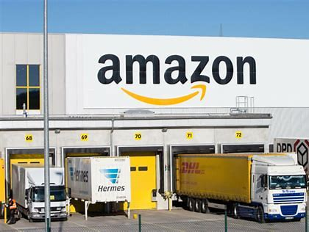
Known Knowns
Notes:
Example: Amazon and Logistics Excellence Amazon knows that fast, reliable delivery is a core driver of customer satisfaction. They have years of data (Prime adoption, repeat orders, CSAT scores) proving this. That’s why they invest heavily in warehouses, last-mile delivery, and even drone pilots.
Known Known: Logistics speed drives loyalty.
Action: Double down on building infrastructure (like Amazon Prime, Fulfillment Centers).
Why it matters: This is where companies invest confidently because the relationship between effort and outcome is well validated.
Example: Apple and Ecosystem Lock-in Apple knows that when customers buy multiple Apple products, their lifetime value goes up (AirPods, iPhone, Mac, Watch all working seamlessly).
Known Known: Ecosystem stickiness = customer retention.
Action: Continuously integrate hardware + services.

Slide 7

Known Unknown
7
Notes:
Known Unknown: Whether Netflix could successfully produce and distribute original content that would attract and retain subscribers.
What Happened? Netflix initially operated purely as a streaming service, licensing shows and movies from existing studios. However, the company knew that relying solely on third-party content posed risks, especially as content owners started creating their own streaming services.
In 2013, Netflix took a calculated risk by producing its first major original series, “House of Cards”. They knewthere was a gap in understanding:
Could Netflix transition from being just a distributor to a content creator?
Would original content drive subscriber growth and improve customer retention?
How They Addressed the Known Unknown: Netflix leveraged data analytics to mitigate uncertainty. They analyzed viewing habits, genre preferences, and actor popularity (e.g., Kevin Spacey and David Fincher’s strong audience appeal) before green-lighting the project.
While they had data suggesting a high likelihood of success, there were still unknowns—how would the market respond to Netflix-produced content? Would audiences accept a streaming platform as a content creator?
Impact:
“House of Cards” was a massive success, earning critical acclaim and leading to a surge in subscribers.
This validated Netflix’s move into original content and transformed it into one of the world’s largest studios.
It also changed the entire entertainment industry, leading to the “streaming wars” we see today.
Why It’s a Known Unknown:
Netflix knew there was a knowledge gap around audience acceptance of original streaming content.
They identified the risk but used data and calculated bets to move forward.
Unlike an unknown unknown, they were aware of the uncertainty and proactively worked to fill in the blanks.

Slide 8

Unknown Known
We know it somewhere,
but it’s not surfaced or used in decision-making
Notes:
Example: Nokia and the Smartphone Shift Internally, Nokia engineers knew about the limitations of Symbian and the growing importance of software ecosystems (apps, developer community). But this knowledge was buried, deprioritized, or politically ignored by leadership focused on hardware dominance.
Unknown Known: Teams knew the OS was outdated, but leadership didn’t act.
Consequence: Lost the smartphone market to Apple and Android.
🔹 Another Example: Google+ Failure Inside Google, many employees and even early testers knew user engagement on Google+ was low and that people were not inclined to leave Facebook. But leadership kept pushing the project, ignoring those internal signals.
Unknown Known: They already knew user traction was weak, but it wasn’t acknowledged.

Slide 9

Unknown Known
We know it somewhere,
but it’s not surfaced or used in decision-making
Notes:
Unknown Known: Tiny Speck (the company that became Slack) was building a multiplayer game called Glitch. To collaborate, the team had created an internal chat + file sharing tool. They knew it was useful for their own workflow, but they didn’t think of it as a “marketable product” initially.
Unexpected Success: When Glitch failed, they pivoted the internal tool into Slack. The value (real-time team communication) was already known internally but not acted upon strategically until the game failed.
Outcome: Slack became one of the fastest-growing B2B SaaS products in history.

Slide 10
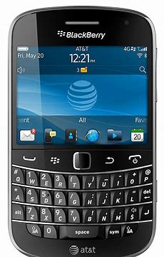
Unknown Unknown
10
Notes:
Case: BlackBerry and the iPhone Disruption
Unknown Unknown: The shift in consumer behavior towards full touchscreen smartphones and app ecosystems.
What Happened? In 2007, BlackBerry dominated the smartphone market with its physical keyboards and enterprise-focused security features. The company was confident in its understanding of its customers—primarily business professionals.
When Apple launched the iPhone with a full touchscreen interface and an emphasis on consumer-friendly features, BlackBerry’s leadership dismissed it. They underestimated the massive appeal of touchscreens and the potential of the App Store ecosystem to reshape user expectations.
The idea that business users would also desire the same sleek design, intuitive UI, and rich app ecosystem was an unknown unknown for BlackBerry—they didn’t know that they didn’t know their users’ latent desires.
Impact:
BlackBerry failed to pivot quickly.
They continued focusing on hardware keyboards and enterprise features, missing the broader market shift.
Within a few years, iOS and Android took over the market, and BlackBerry’s market share plummeted.
Why It’s an Unknown Unknown:
BlackBerry wasn’t even aware that user expectations were shifting so dramatically.
The company focused on what its current users said they wanted (keyboards, security) but failed to uncover what they didn’t even know they desired yet—an engaging, touchscreen-first experience with access to apps.

Slide 11
Who Can Help With Unknowns?
Customers
Partners
Suppliers
Experts
Regulators
…
11
Notes:
Customers/ Partners/ Experts

Slide 12
Involve Your External Stakeholders?
Should you involve your customers and partners while crafting your strategy?
Aren’t customers beneficiaries of your output?
12
Notes:
Internally you are only seeing your views – Could be biased
External conversations give you broader perspectives – Known Known

Slide 13
Involve Your External Stakeholders?
Should you involve your customers and partners while crafting your strategy?
Aren’t customers beneficiaries of your output?
Are there risks involved?
They could copy
Miscommunication
It’s a Double-Edged Sword – Handle with Care
13
Notes:
Internally you are only seeing your views – Could be biased
External conversations give you broader perspectives – Known Known

Slide 14
Building Credibility
Internally
Externally
14

Slide 15

Focus: Solve the Problem
Don’t focus on implementing the feature
Example: Aadhar Validation Vs DRM
Then you become a
Problem Solver
and not just an order taker!
15

Slide 16
Preparing for customer meet
Here & Now
Support issues – Support
Usage data – Metrics
What’s coming – Product
Hot Topics – Customer Success
Future
Where are you going? What are your big worries?
What are we thinking/ planning?
16

Slide 17
Preparing for Partner Meet
Here & Now
Open Issues
Usage/ Cost data
Future
Where are you going?
What are you thinking/ planning
Where are we going?
What are we thinking/ planning?
17

Slide 18
What if you already know the answer?
While I already have “this” perspective,
would love to hear your perspective,
so that I have a better more complete picture
18

Slide 19

Breakout Room: Stakeholder Radar
Pick one product/ feature/ solution you’re working on
What are some Known Knowns, Known Unknowns?
What could be Unknown Knowns, and Unknown Unknowns?
Who could help move things from Unknowns to Knowns?
How should you frame that conversation?

Slide 20
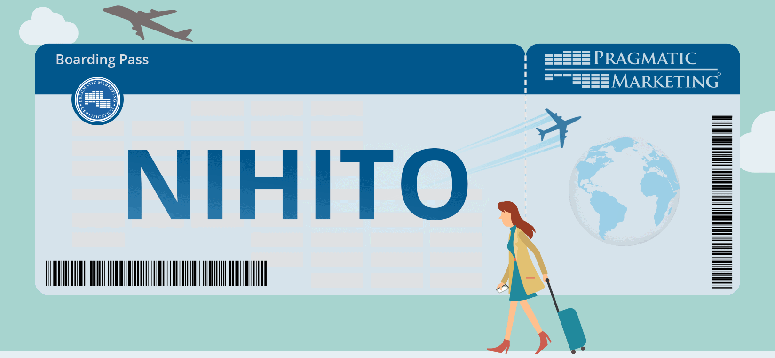
NIHITO
20
Notes:
Meet external stakeholders whenever you can – Customer meetings, field visits. Share the insights you gain with your team as well.

Slide 21




Geography Limitations?
21

Slide 22

It’s A Virtual World
Turn on video
Background blur
22

Slide 23


Travel for Events
23
Notes:
Meet customer at conferences. Internal stakeholders for internal offsites/ sales kick off.
Forever thankful to my director at the time for having invested in 3 US trips for me in a span of 6 months. The relationships developed during those 3 trips helped me for the next 4 years!

Slide 24
Customer Advisory Board
Why do you need a Customer Advisory Board –
To advise you on strategy
Who should be part of it?
Key customers
Based on nature of relationship with you
Based on nature of relationship among themselves
How often should you meet?
Quarterly (more often if needed)
What should be the Agenda?
Validate findings/ approach
Validate roadmap
Identify blind spots/ gaps
24

Slide 25

CAB Driven Strategy
Expansion into Europe based on customer input
25
Notes:
Expansion from saturated US market to European market. Working together with existing US customers to target their EU operations. Win-Win - They get familiar proven product in EU, we get to grow our business. The countries to focus on decided in partnership with customers.

Slide 26
Partner Driven Strategy
Mid Market Expansion
26
Notes:
Expansion from Fortune 200 to Fortune 2000. Needed a sales team to reach the increased number of target customers and associated sales cycle. Partnered with an external agency to reach the customers.
Exclusivity contract with the partner for the 1st year to help the partner gain momentum.

Slide 27
Beta programs
Identify
Define success criteria
Train & onboard
Periodic touchpoints
Feedback templates
27

Slide 28
Progress Demos
Set context
Show & tell
Get feedback
Build excitement
28

Slide 29
Module 1 – Summary
Stakeholder Engagement
Need for Stakeholder Engagement to be Agile
Understand Your Audience
Categorizing stakeholders on Interest & Influence
Making time to engage with stakeholders
Internal & External stakeholders
Make time to understand the needs and pains of your stakeholders
29

Slide 30
Takeaway
Your job isn’t to know everything
Your job is to engage stakeholders so that the unknowns shrink and you can make better decisions
The Rumsfeld Matrix isn’t about knowledge; it’s about humility and curiosity

Slide 31
Influence Areas
Budget
Timeline
Scope
31

Slide 32

Questions

